Slide 1


RAPID RESPONSE SYSTEM
APPLICATION ENGINEERING DEVELOPMENT PROJECT – INFO5100
SPRING 2021
Presented By:
Rakshith Chandrashekar(001006556)
Sanjit Sateesh(001090471)
Sharan Chandra Shekar(001582721)

Slide 2
Problem Statement:
The world as we know it has changed forever because of covid-19. the pandemic has affected everything, starting from health of the people to the global economy.
This led all the pharmaceutical organizations on a race to the find the vaccine first for covid-19. this pandemic took a toll on front line workers, the national economy and almost everything that matters.
Managing this pandemic along with other emergencies especially for third world countries is huge ordeal.
Although vaccines have started to roll out, the number of covid-19 cases have not dipped. even in the most developed countries, the number of covid-19 cases are increasing day by day and to handle this pandemic with other emergencies such as a crime/misdemeanor or a fire incident that occurs out of nowhere, it’s a rather strenuous to handle all of these at the same time.

Slide 3
Proposed solution
Healthcare and rapid response is a Java swing application which integrates the basic functionalities of a hospital along with handling COVID-19 as well as attend to the emergencies that is going to be reported.
The purpose of our healthcare and emergency response system is to manage both the COVID-19 situation as well as attend to the emergency situations that may arise during the ongoing pandemic.
Furthermore, this application helps us to keep track of the number of COVID-19 cases and the number of people who have been vaccinated against COVID-19.

Slide 4
Key Functionalities:
COVID-19 testing/result.
Blood donation from healthy patients.
Email Alerts to users regarding their registration and appointment status.
Checking the temperature of person using the camera.
Fire Department, Police department and Medical emergency will be part of 911 response system once user reports a particular type of emergency.
Managing stock of blood donated.
Managing stock of the medicines/drugs in the pharmacy.
Government official viewing the report of number of COVID-19 cases.
Government official viewing the report of number of people vaccinated against COVID-19.
Doctor consulting and prescribing medicine to the patient if necessary.
Register for vaccination.

Slide 5
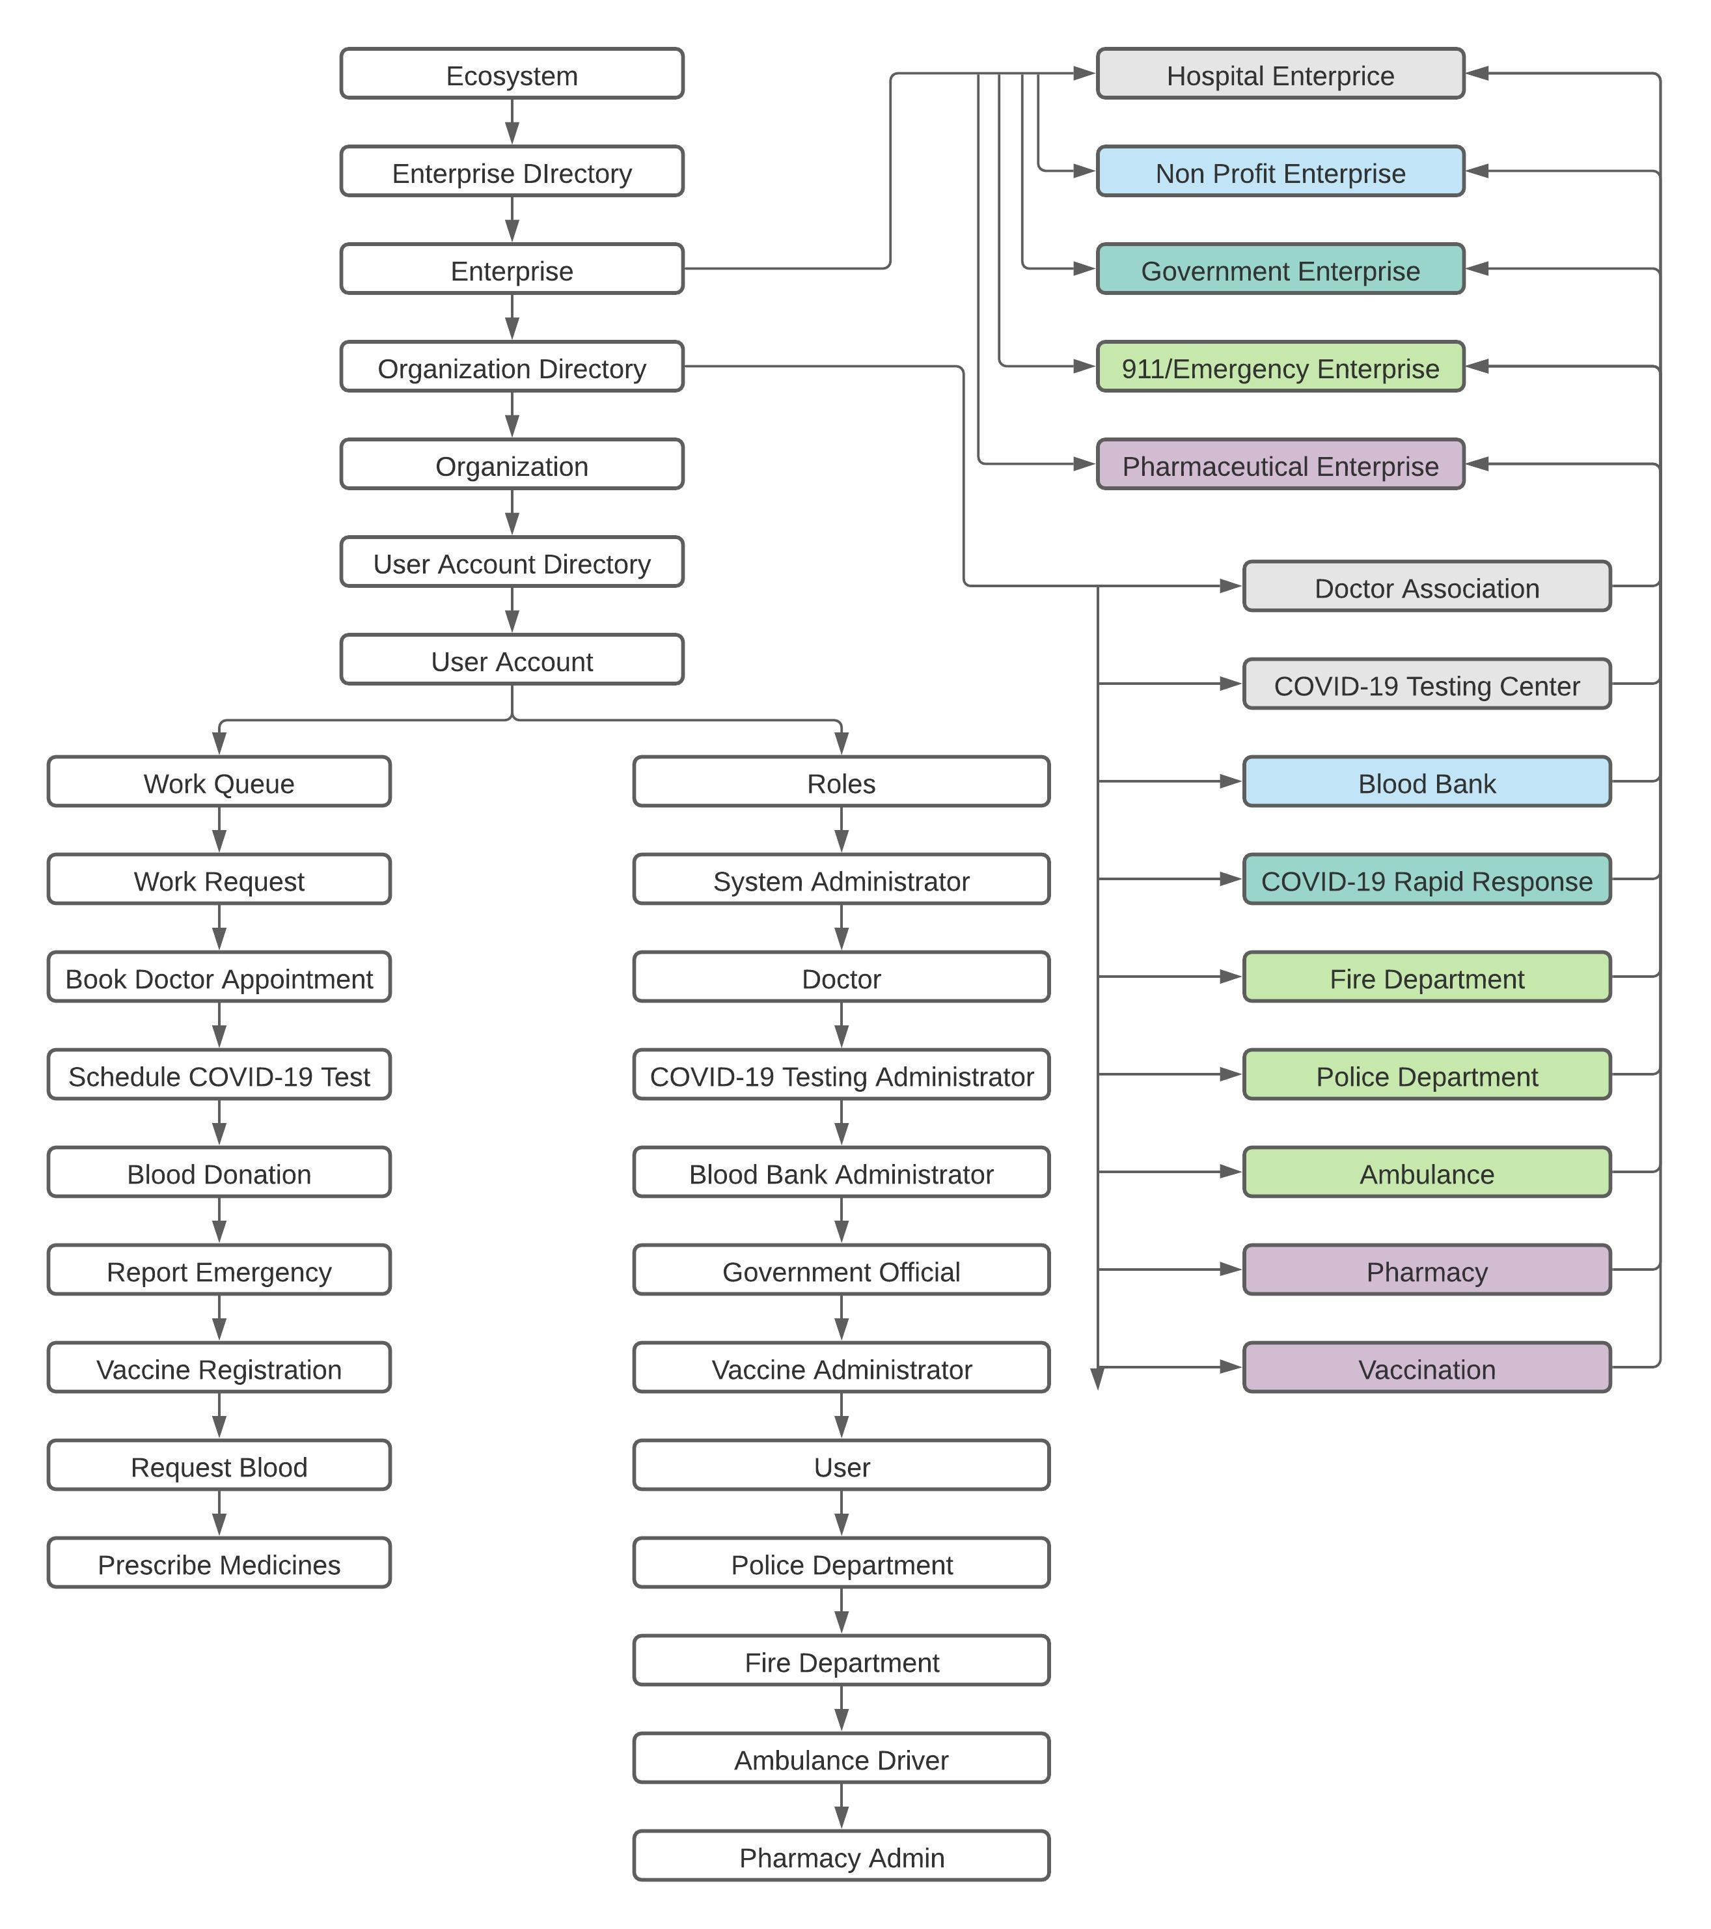

Slide 6
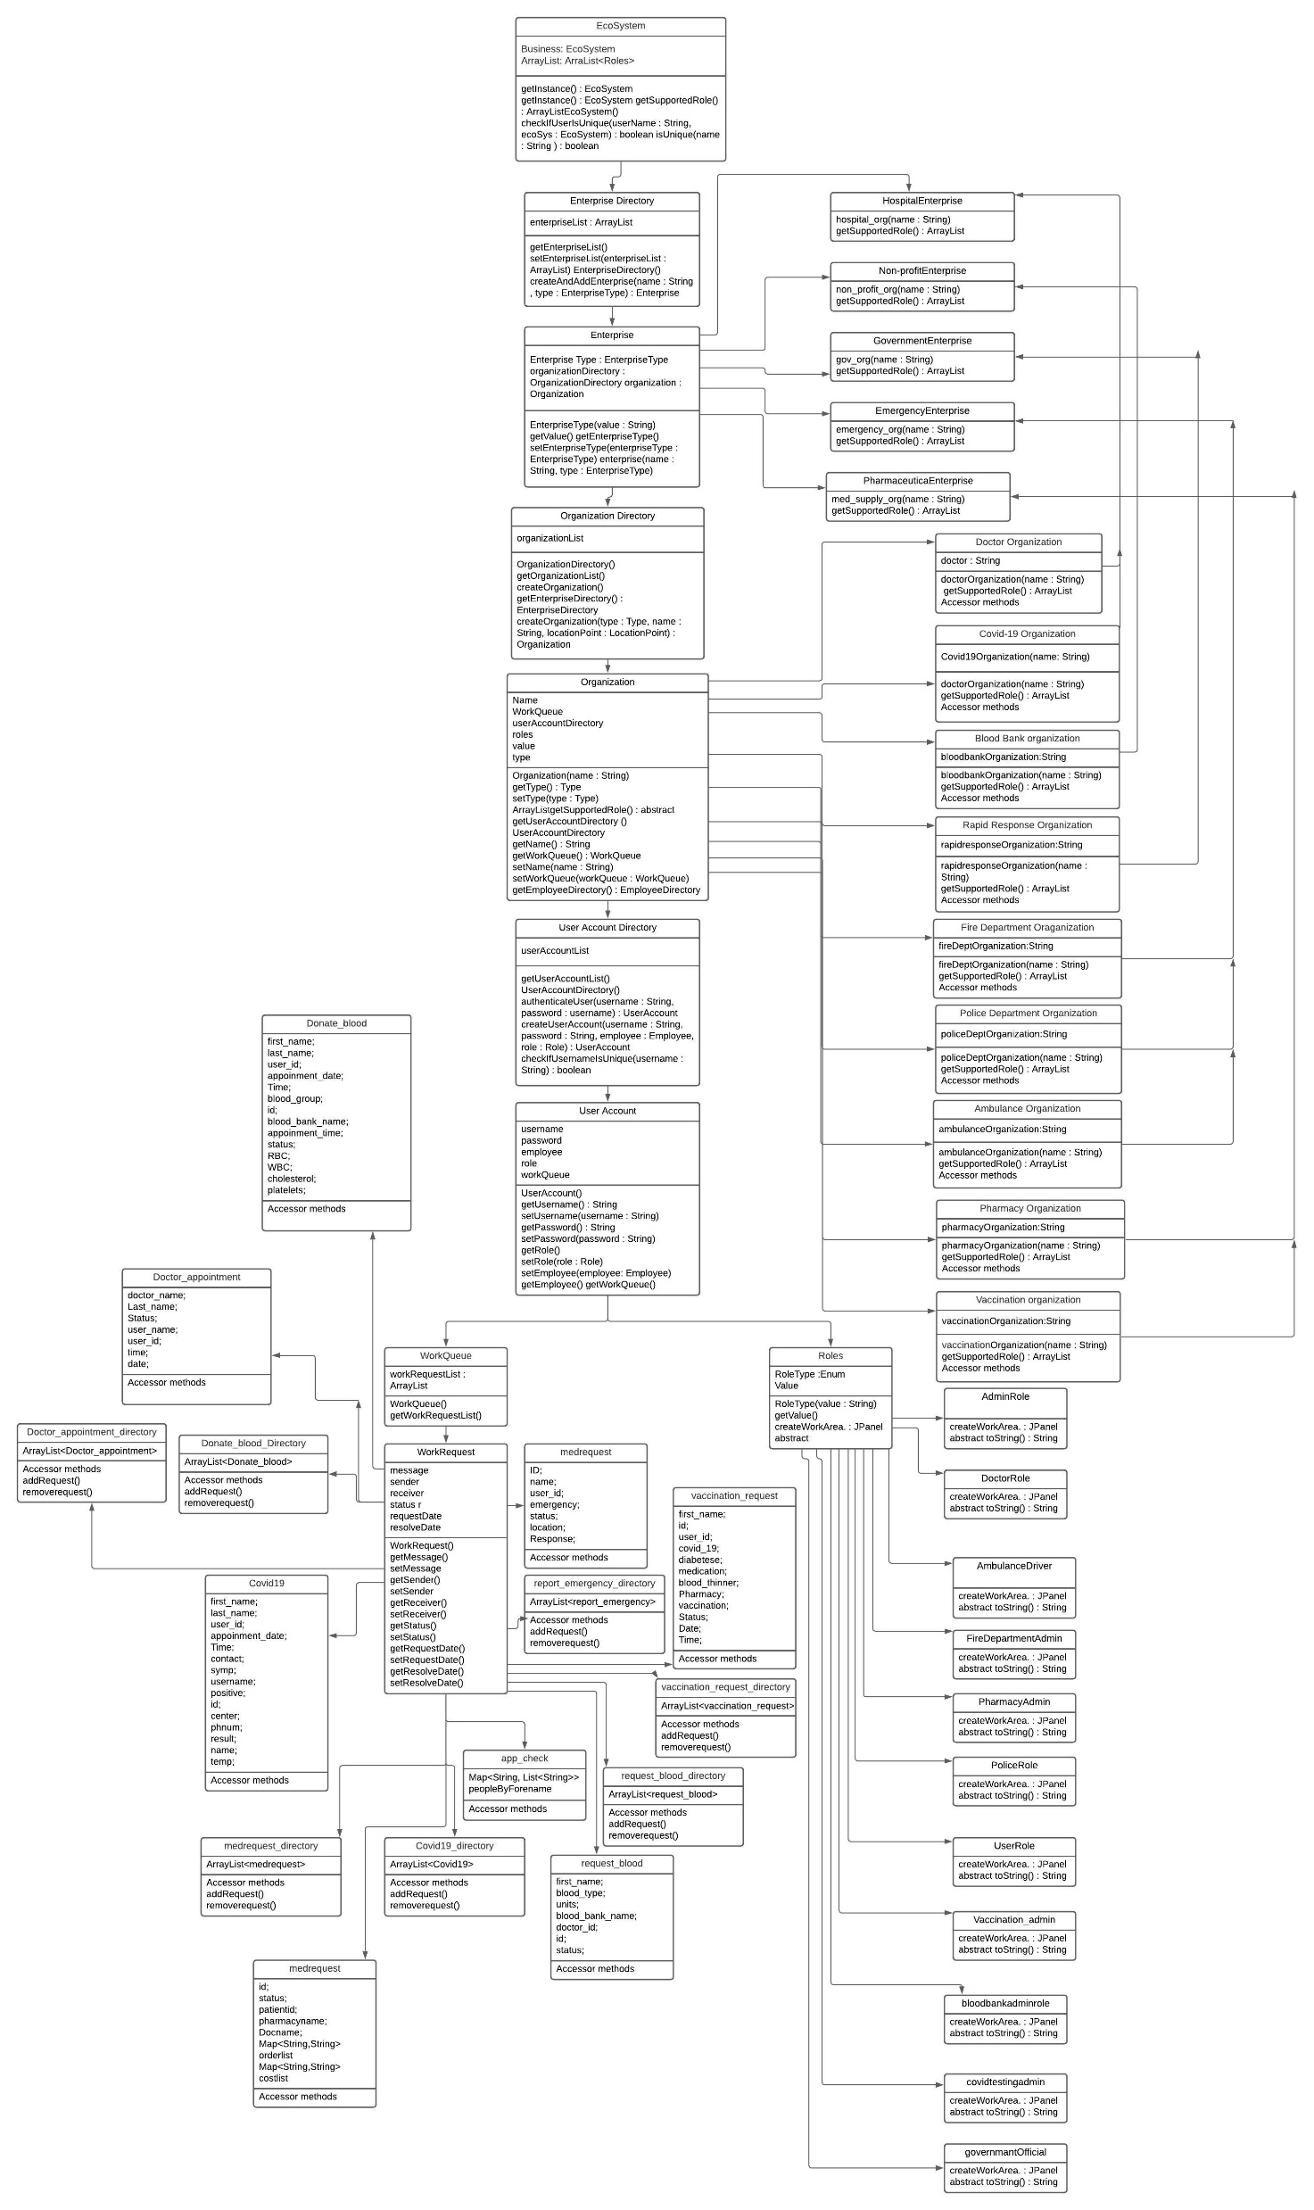

Slide 7
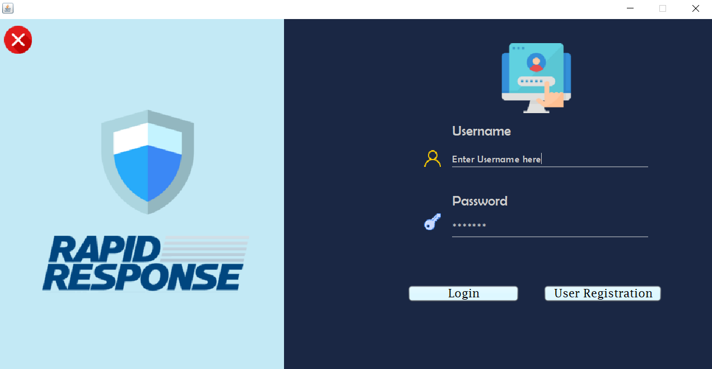

Slide 8
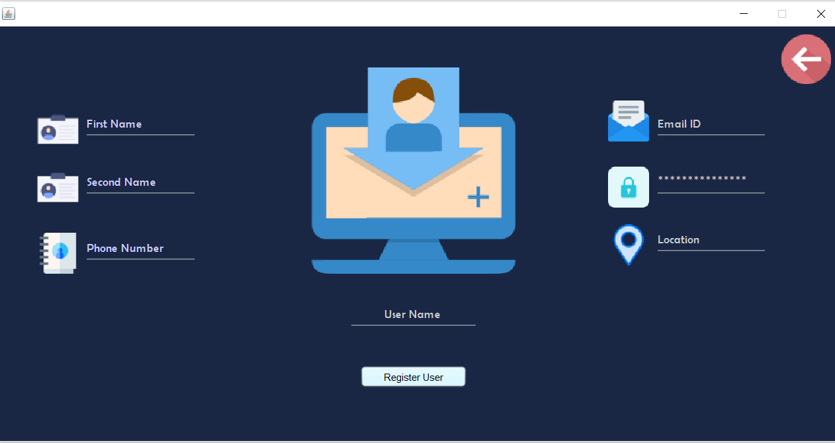
User Registration

Slide 9
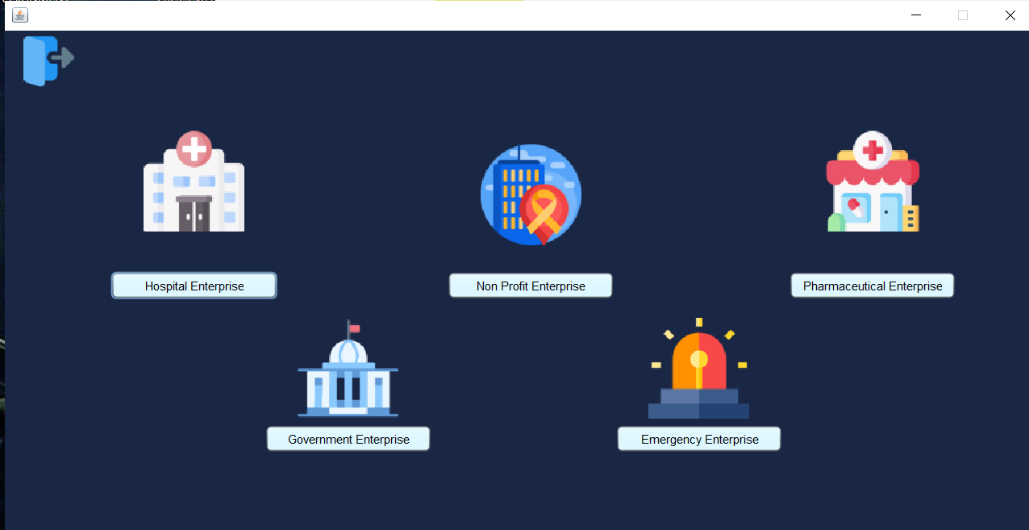
Enterprise

Slide 10
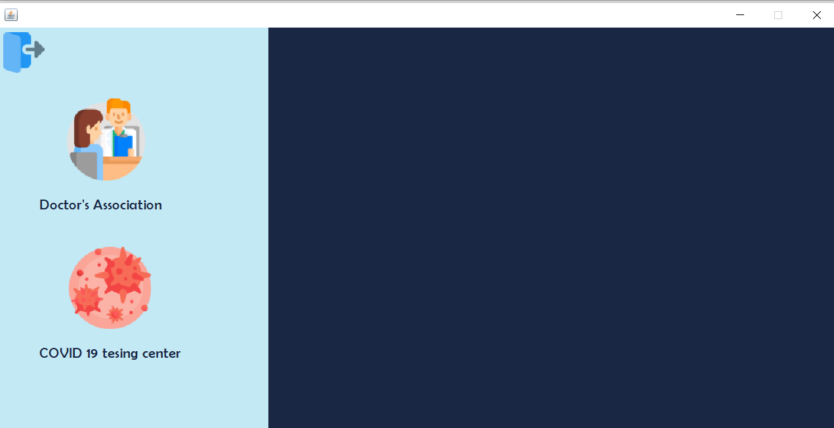
Organization under Hospital Enterprise

Slide 11
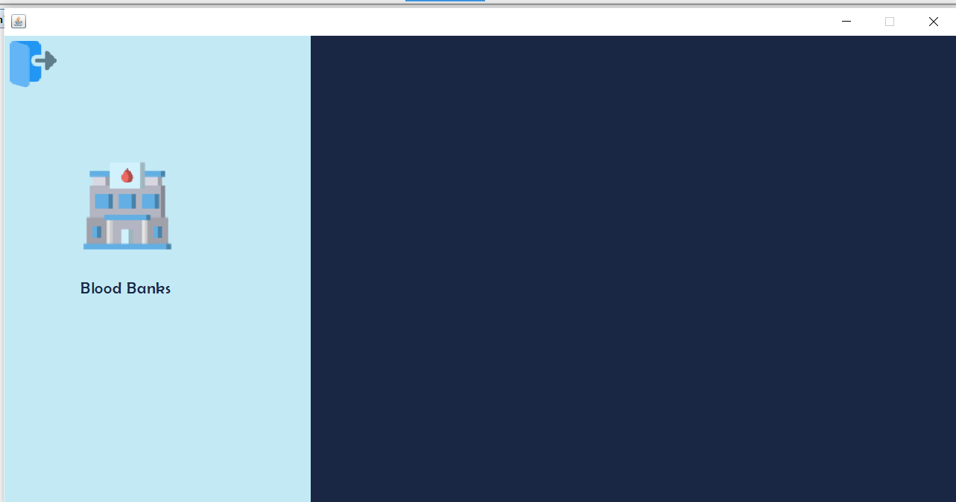
Organization under nonprofit enterprise

Slide 12
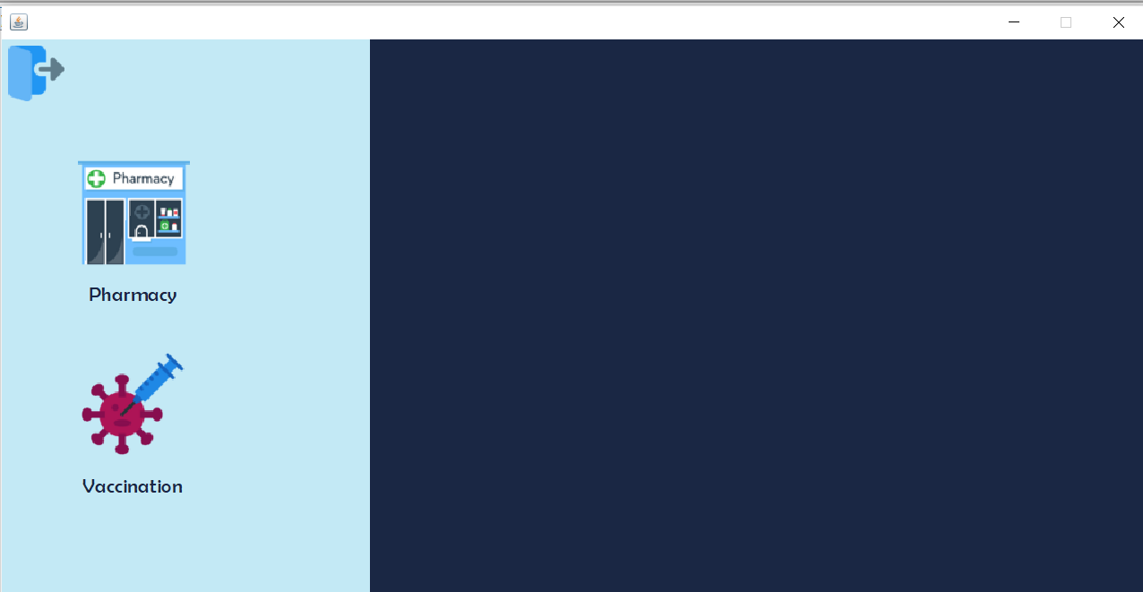
Organization under Pharmacy Enterprise

Slide 13
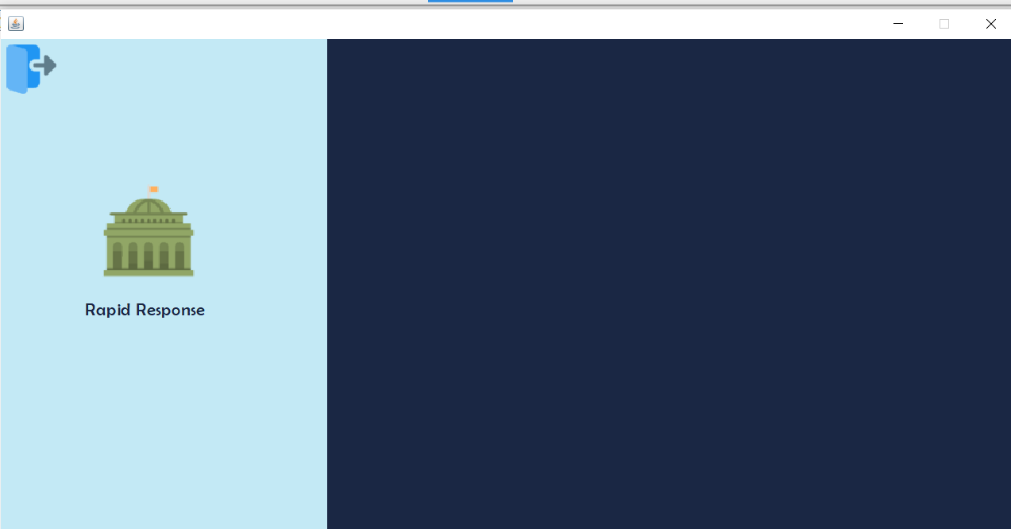
Organization under Government Enterprise

Slide 14
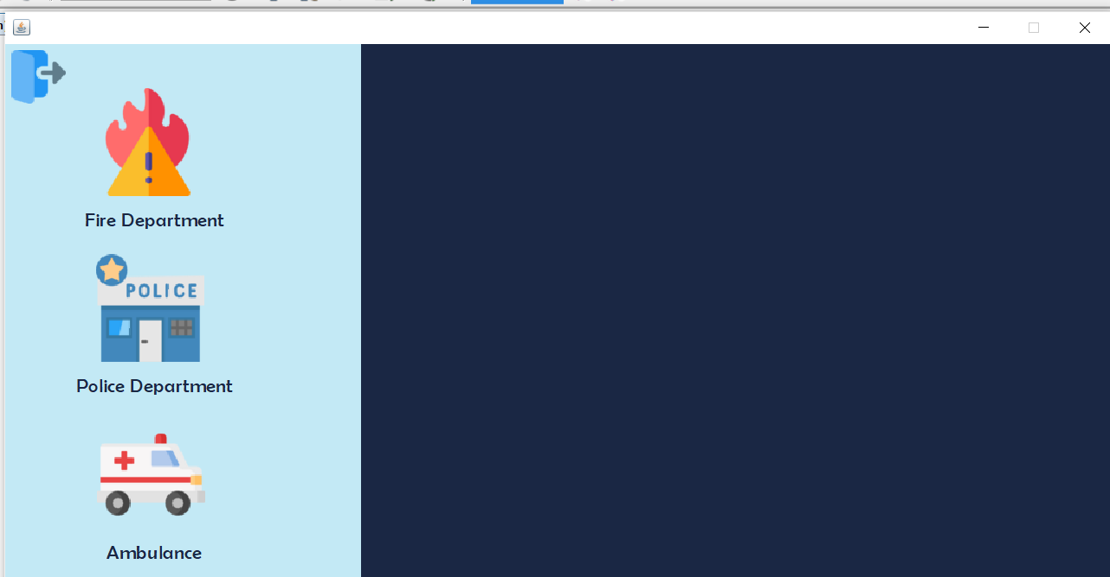
Organization under Emergency Enterprise

Slide 15
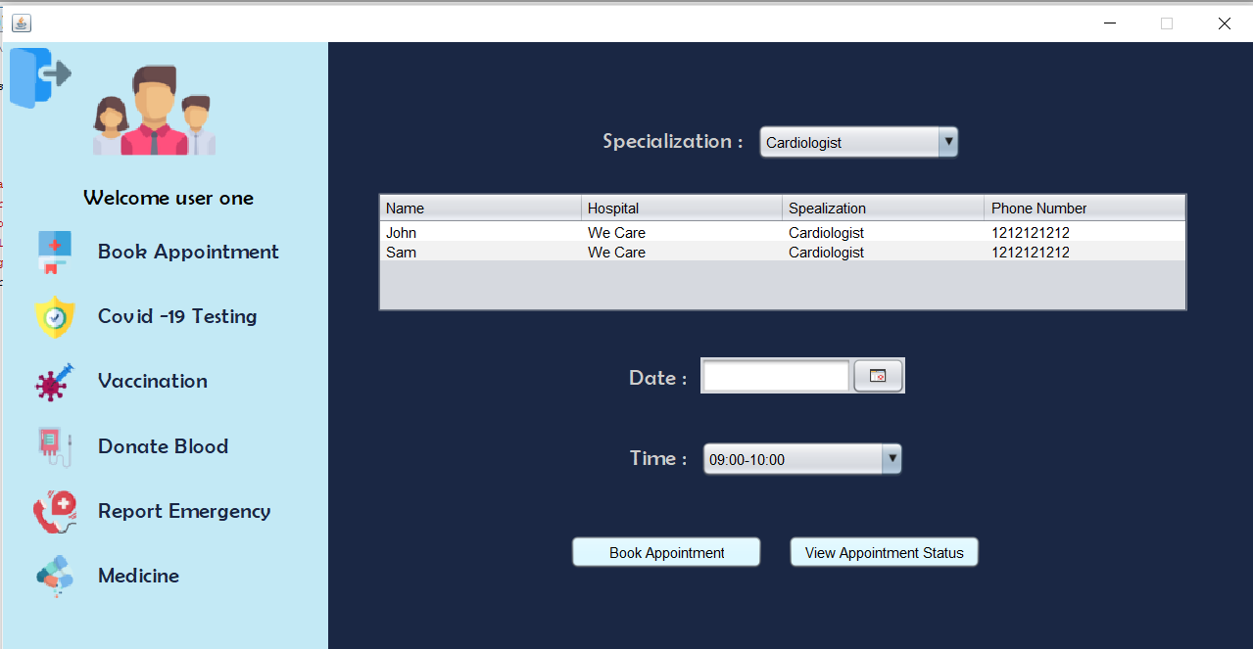
User main panel/ book appointment

Slide 16
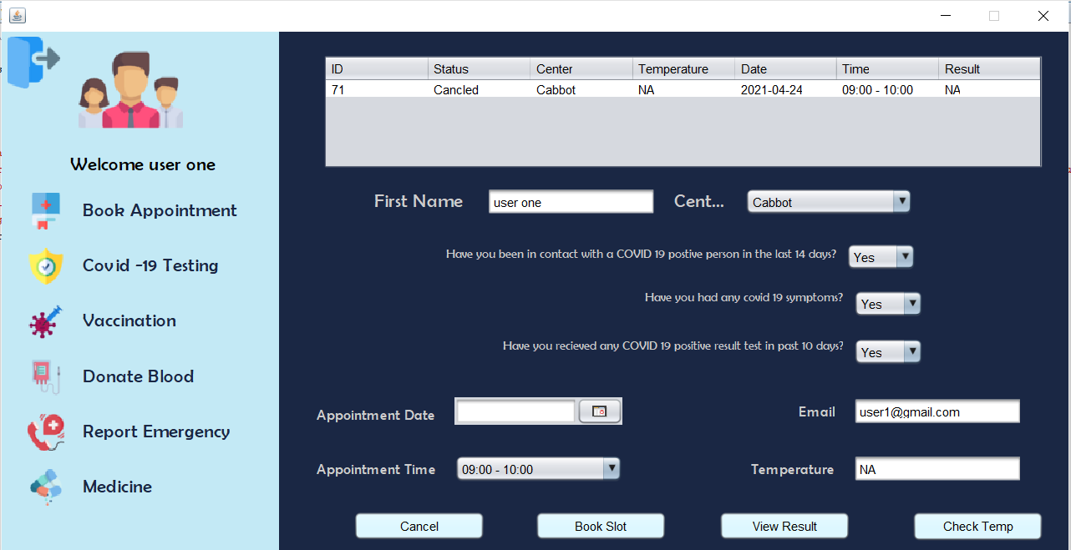
User main panel/ Covid 19 testing

Slide 17
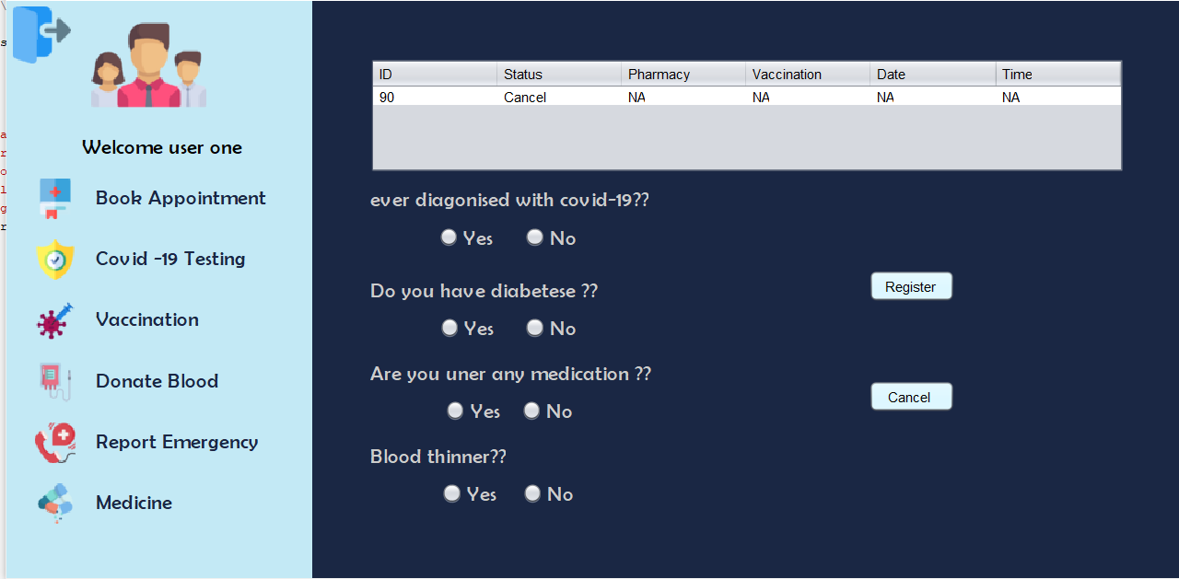
User main panel/Vaccination

Slide 18
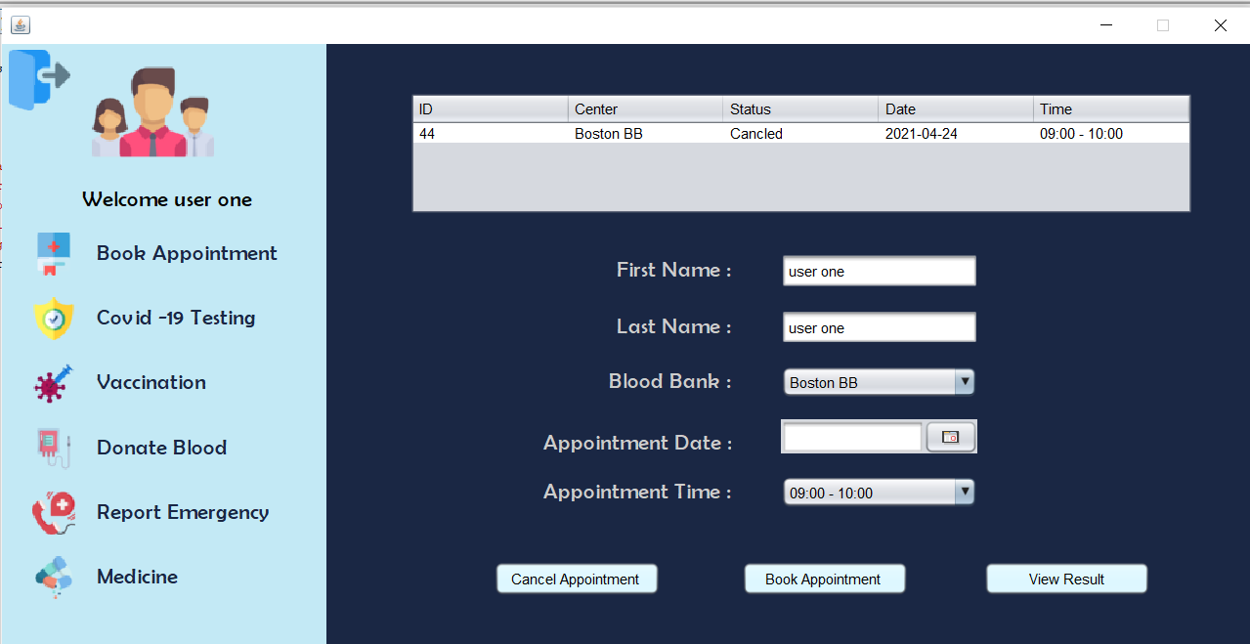
User main panel/ Donate blood

Slide 19
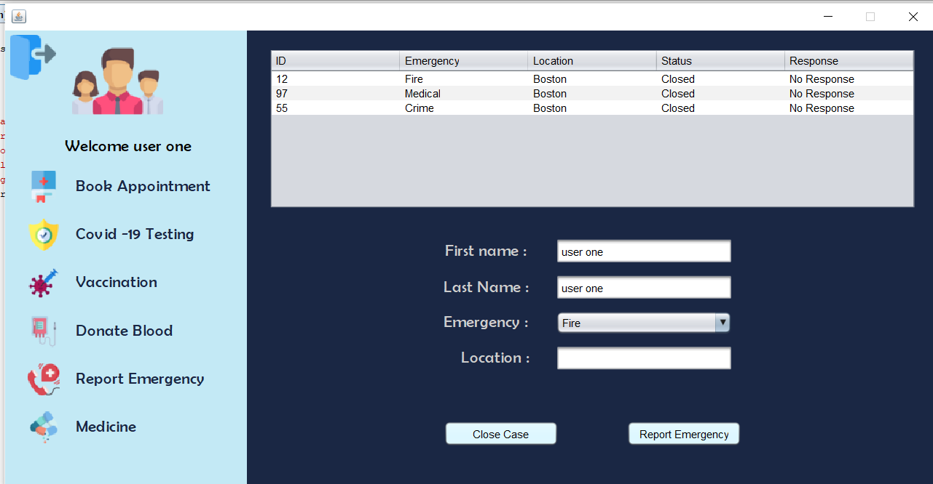
User main panel/ Emergency report

Slide 20
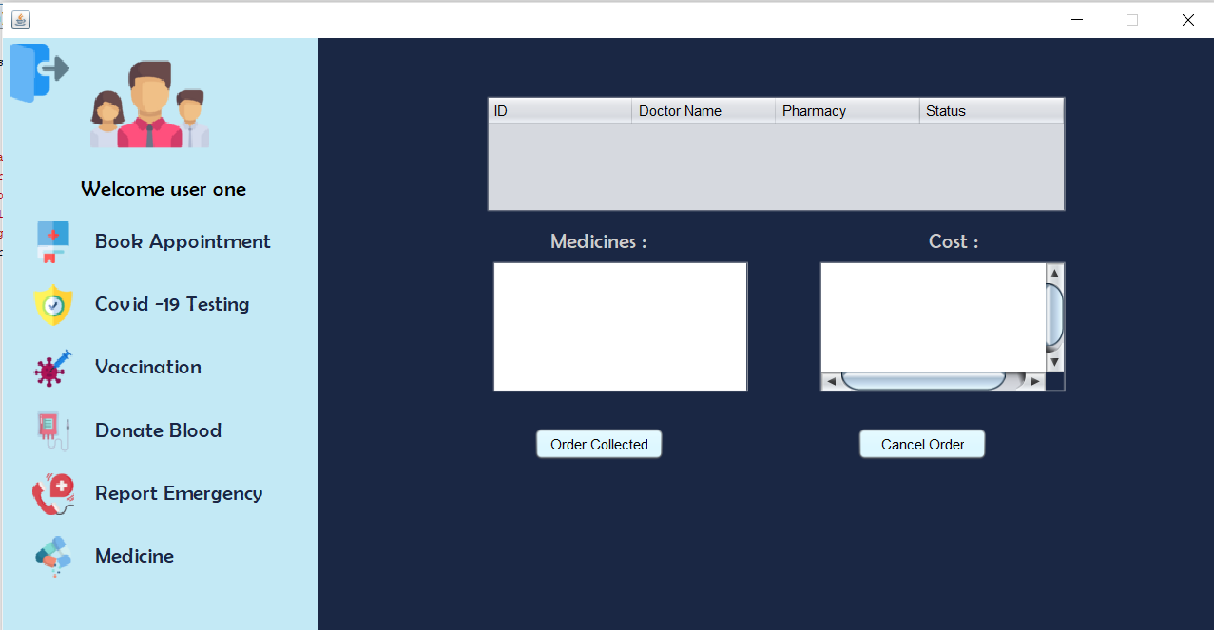
User main panel/Medicines

Slide 21
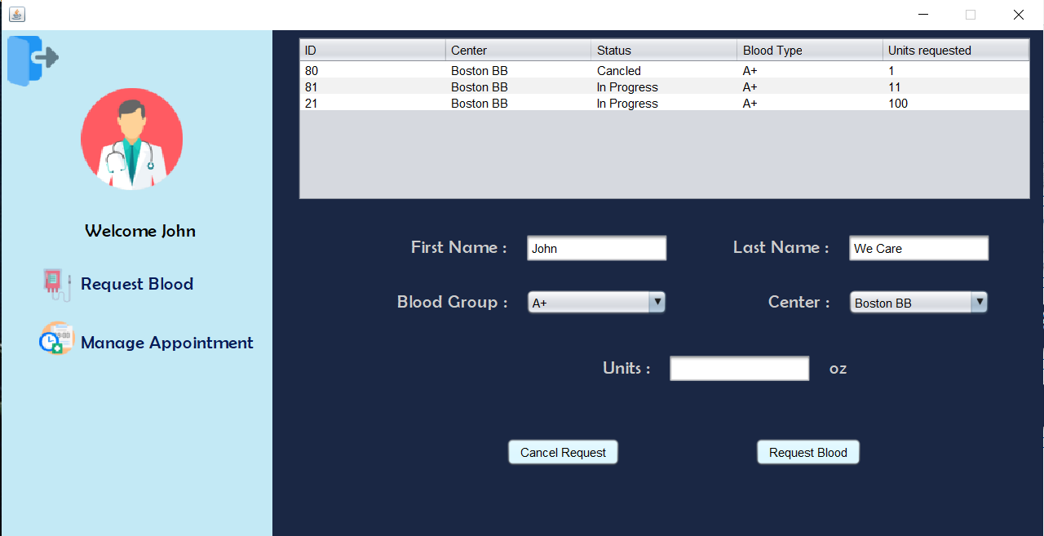
Doctor panel/request blood

Slide 22
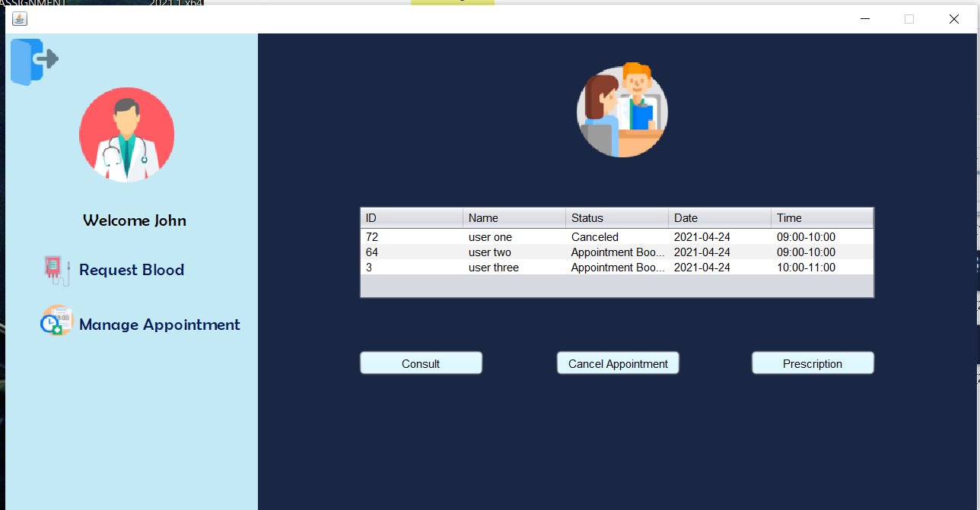
Doctor Panel/Manage appointment

Slide 23
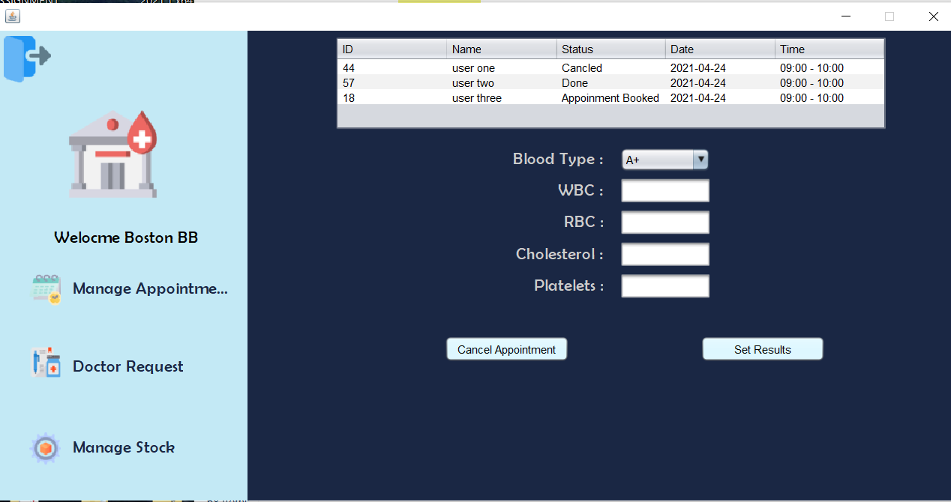
Blood bank panel/manage appointment

Slide 24
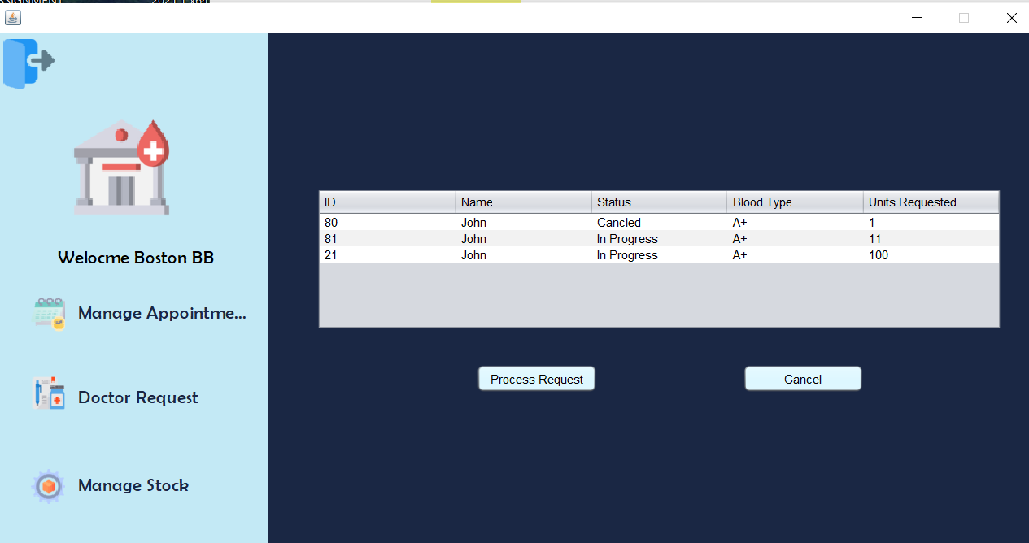
Blood bank panel/Doctor request blood

Slide 25
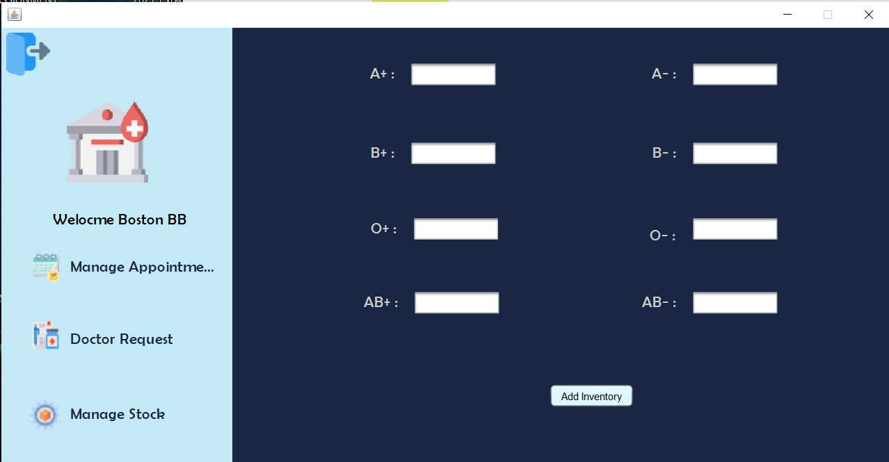
Blood bank panel/manage Stock

Slide 26
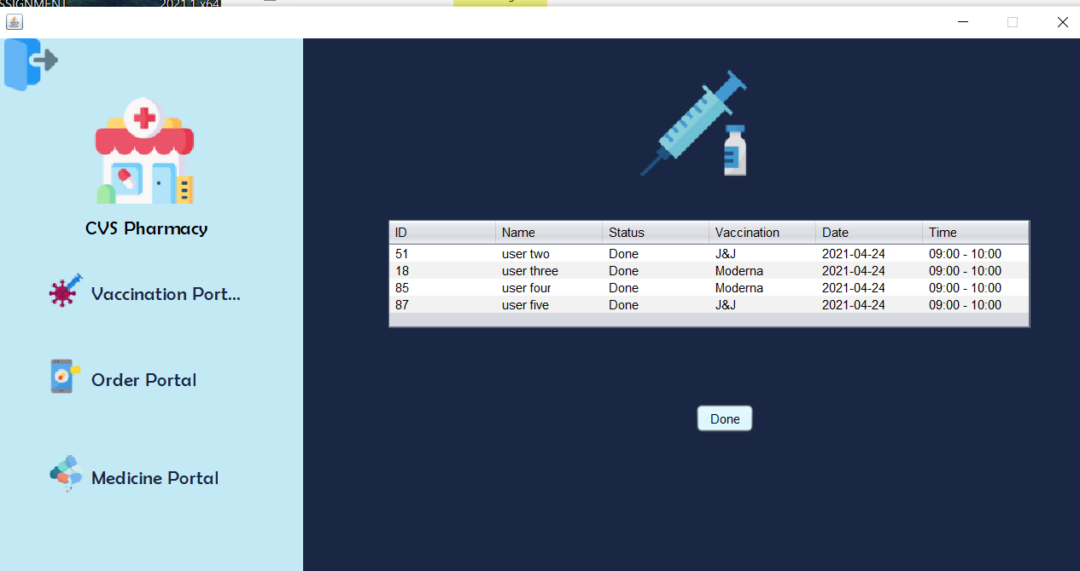
Pharmacy panel/Vaccination

Slide 27
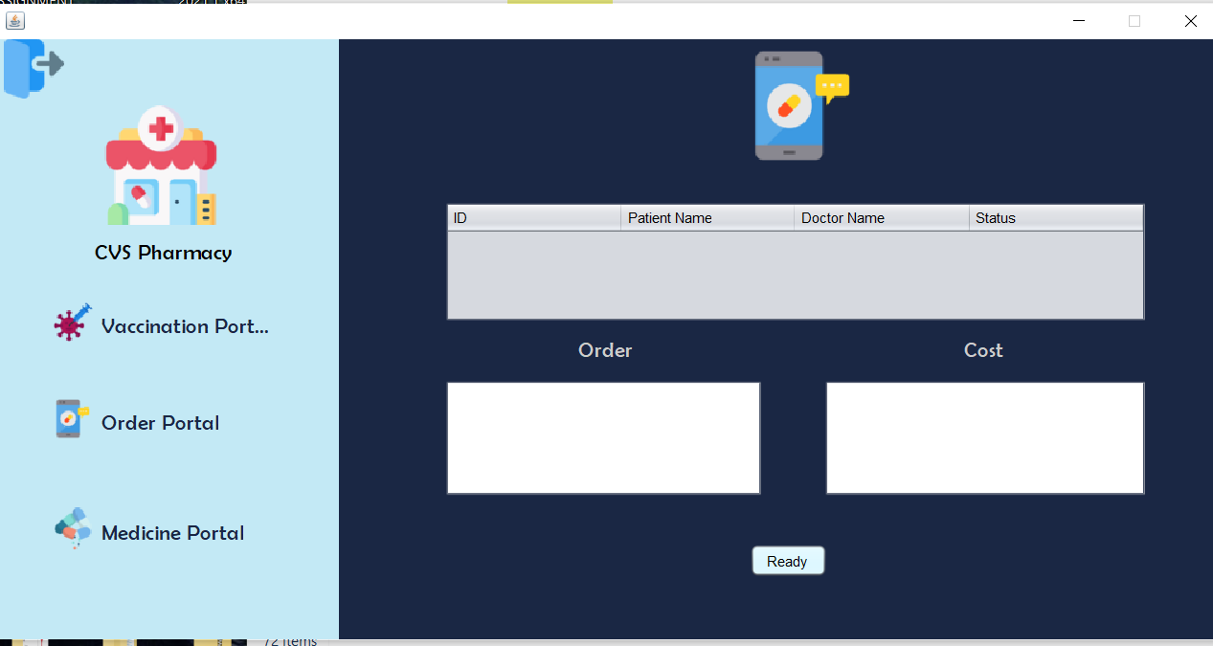
Pharmacy panel/Order

Slide 28
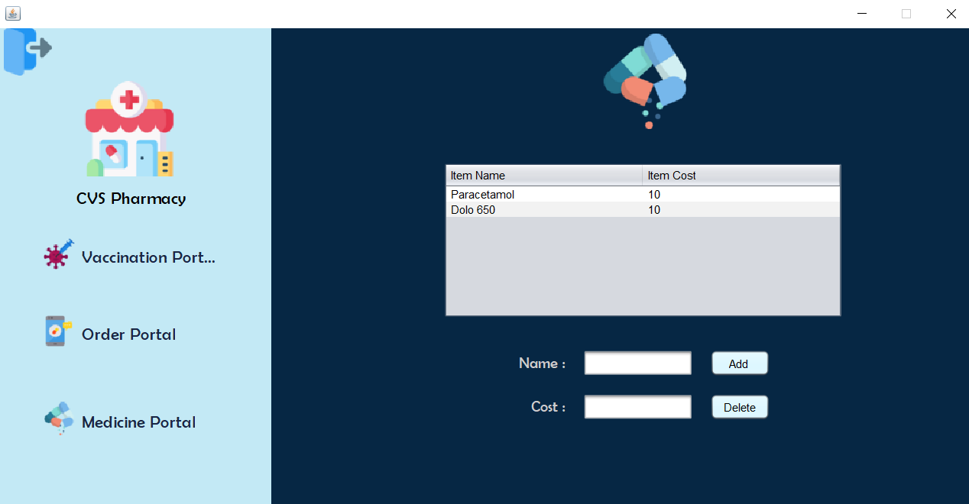
Pharmacy panel/Medicine

Slide 29
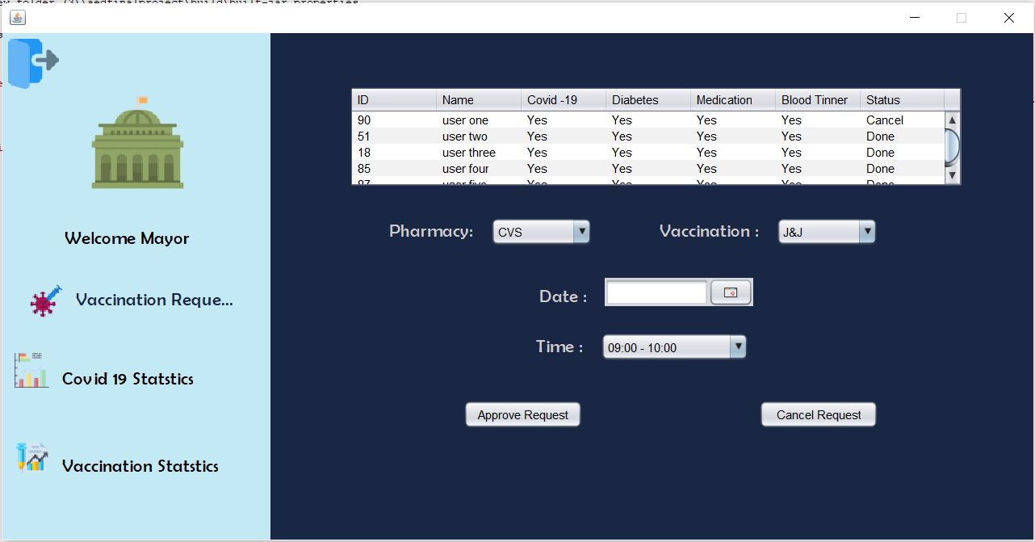
Government panel/Vaccination request

Slide 30
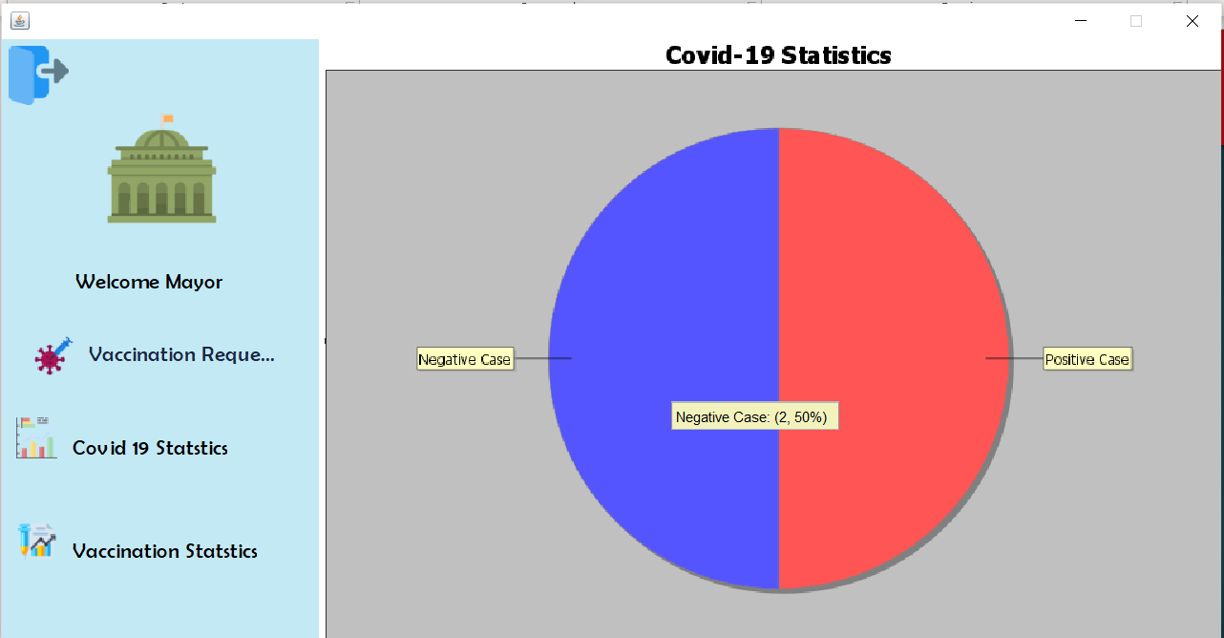
Government panel/Covid 19 statistics

Slide 31
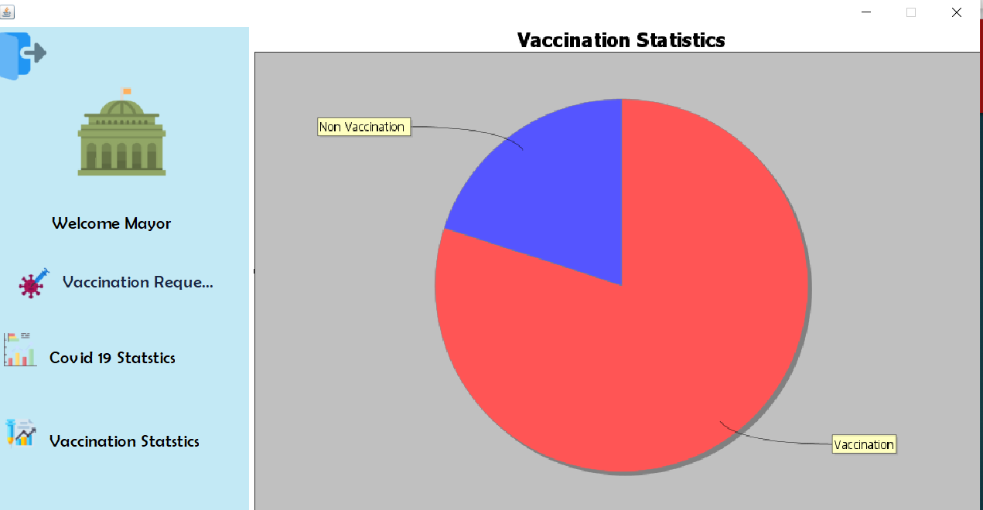
Government panel/Vaccination statistics

Slide 32
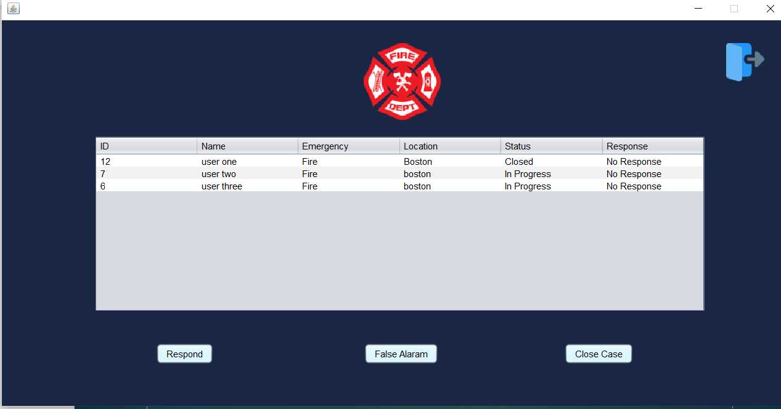
Fire department panel

Slide 33
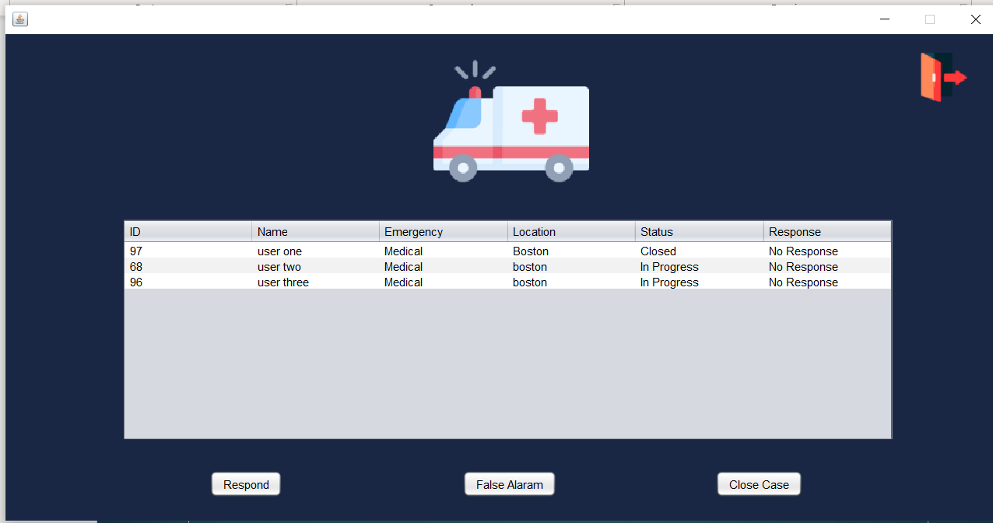
Ambulance

Slide 34
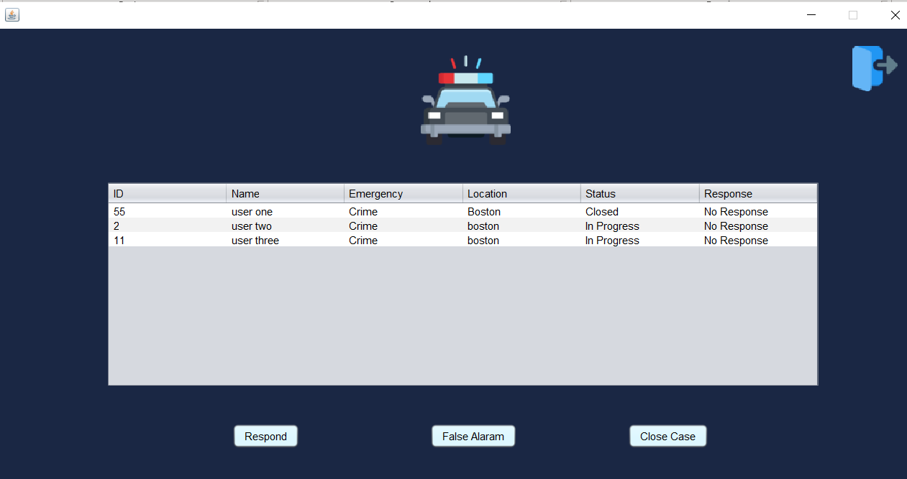
Police Department

Slide 35
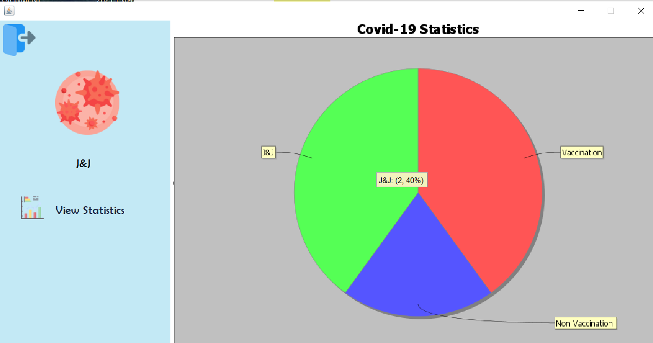
J&J’s Vaccination Statistics

Slide 36
Thank you!
Presented by:
Rakshith Chandrashekar(001006556)
Sanjit Sateesh(001090471)
Sharan Chandra Shekar(001582721)

